Slide 1

Capstone: Fairflow
Name: Rushikesh
x (Twitter)

Slide 2
Problem Statement
Traditional corporate compensation models rely solely on managerial reviews, which can often be subjective and prone to bias.
Many employees are overlooked or under-compensated due to favoritism or lack of visibility.
This results in demotivation, lack of transparency, and an overall decrease in team morale and performance.

Slide 3
My Solution
Decentralized Feedback System- Empower peers and managers to provide performance feedback, recorded transparently on-chain, reducing bias and increasing collective accountability.

Slide 4

Fairflow’s Flow

Slide 5
Contract Specifications
States
Company
Team
Employee
Instructions
Initialize_Company
Create_Team
Register_Employee
Fund_Treasury
Process_Payroll
Submit_Feedback

Slide 6
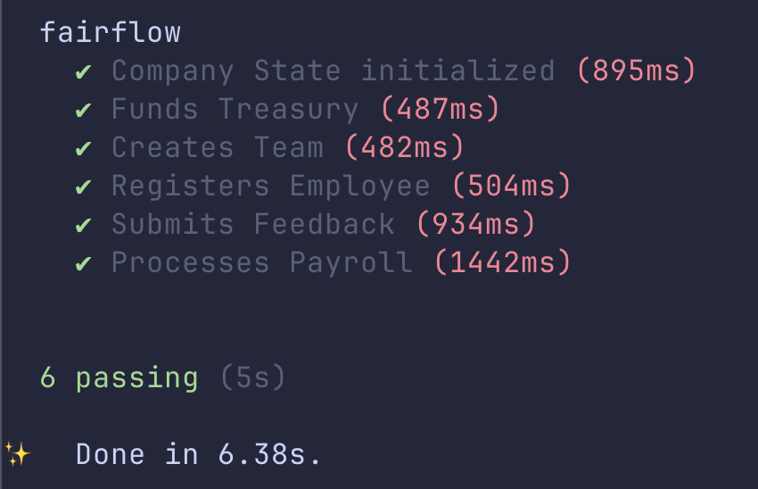
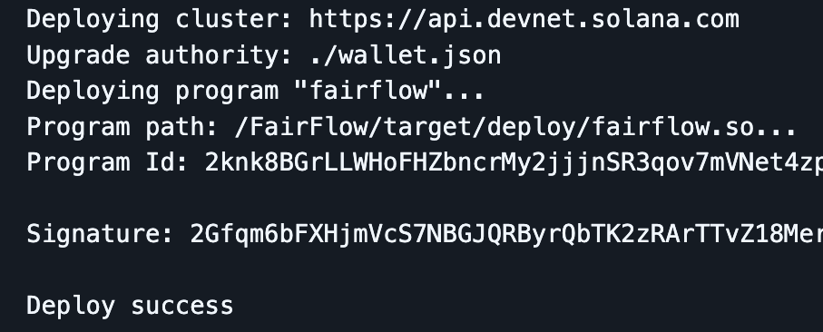
Testing and Deployment
Smart Contract has been tested and Deployed Successfully

Slide 7
Thank You!
Deployed link on Solana Explorer: Link
Github Link for Builder’s Cohort: Link
Github Link for Capstone: Link

